Slide 1

The Cornology Case Study
Team 4:
Alamim Ferreira, Alexandra aedo, Diego polar, and Gianluca scibila

Slide 2

Overview
Case Challenge
Findings
Solving the Problem
Assumptions
Explanation of the Solution
Recommendation

Slide 3
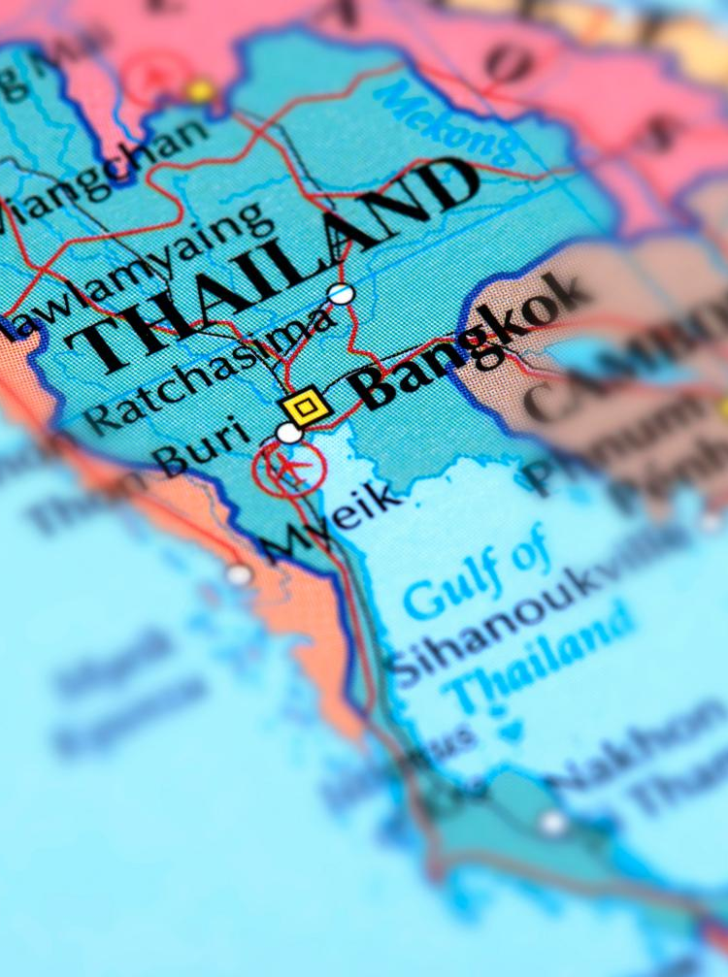
Case Challenge Review
Make a decision on the location of the new popcorn factory
Decide how much of each flavor of popcorn to make and which markets sell it in
Calculate the profit for the chosen markets
Provide the Market share for each product based on total demand across all given regions

Slide 4
Findings (Research on weather conditions and labor workforce)
Chiang Rai :
Q1 weather conditions are favorable. There is a less than 10% chance of precipitation. The average high temperature is between 81- and 91-degrees Fahrenheit. Workforce: 745,3k
Nong Khai :
The highest temperatures range between 82- and 90-degrees Fahrenheit for Q1. There is a less than 20% chance of precipitation. There is an influx of immigrants, primarily from Vietnam, to Thailand's northern regions.
Workforce: 296k
Yala: Good weather conditions are expected for the first quarter of 2016 in terms of temperature, wind, and precipitation. Labor force 280 K. LOW in comparison to other regions. and if there is a work shortage, that is a factor to consider
Bangkok: The metropolitan area is expected to have approximately 44 percent of the immigrant workforce in 2016. and there may be a labor shortage as a result of Thailand's megaprojects In Q1, there is a less than 20% chance of rain. Temperatures range from 88 to 90 degrees.

Slide 5
Impact of the findings (Assumptions)
Chiang Rai :
As explained in the case, for the Chiang Rai factory there are $700,000 of uncertainty to be added to the initial cost
Nong Khai : We suppose that because of uncertainty of the workforce, there are $300,000 to be added to the cost of the factory
Yala: Because of uncertainty in the workforce, we added $360,000 to the cost of the factory
Bangkok: Thanks to the high choice in workforce, Bangkok doesn't have any additional cost due to the workforce.

Slide 6
Solving the Problem
Because we are assuming that every unit sold makes profit, in order to maximize the overall profit, we must maximize the overall sales. Because of this, the constraint of 90% production to enter the market is always satisfied. Furthermore, the real decision is on which factory to build, based on the best route achievable based on the factories. This way we found that each factory had an optimal route: Nong Khai would be NorthEast and YRD, Chiang Rai would have North Central and South Central, Bangkok would have YRD and Northeast and Yala would have Western China, Northcentral and North East. At this point the optimization model will evaluate which of this routes, based on the costs, will propose the best outcome. This makes this optimization model a Binary model, in which the constraint is that there can be only and at least 1 factory.

Slide 7
Solution
Given this model, the optimal solution is to build the Yala Factory, which would produce a loss of $7,003,601. However, this is the loss would be only for the first quarter, as we project the same revenues over every quarter. The payback period for this project is 3.23 Quarters (a bit over 9 months). However, from a payback period Standpoint, the Nong Khai factory has a lower payback (3.20), even if the loss for the first quarter is higher ($-7,937,161). For this reason, our suggestion is to build the Nong Khai Factory.

Slide 8
Recommendation
Construct the Nong Khai Factory:
Pleasant weather conditions are predicted for the first quarter of 2016
The additional costs will be minimal compared with most of the locations ($300,000)
The shortest payback period (3.20)

Slide 9

Thank You

Slide 10
Reference
Yala Climate, Weather By Month, Average Temperature (Thailand) - Weather Spark. (n.d.). Weather Spark. https://weatherspark.com/y/113846/Average-Weather-in-Yala-Thailand-Year-Round
Chiang Rai, Weather By Month, Average Temperature (Thailand) - Weather Spark. (n.d.). Weather Spark. https://weatherspark.com/y/113125/Average-Weather-in-Chiang-Rai-Thailand-Year-Round
Nong Khai, Weather By Month, Average Temperature (Thailand) - Weather Spark. (n.d.). Weather Spark. https://weatherspark.com/y/114326/Average-Weather-in-Nong-Khai-Thailand-Year-Round
Bangkok, Weather By Month, Average Temperature (Thailand) - Weather Spark. (n.d.). Weather Spark. https://weatherspark.com/y/113416/Average-Weather-in-Bangkok-Thailand-Year-Round

Slide 11
Reference
Workforce by Region in Thailand , Knoema. (n.d.). Knoema. https://knoema.es/atlas/Tailandia/Yala-Province?compareTo=TH-101,TH-57,TH-43
Labor shortage issue 2016-2017, Erina Suzuki https://www.internationalhousingassociation.org/fileUpload_details.aspx?contentTypeID=3&contentID=259600&subContentID=706730&channelID=38488

Slide 12
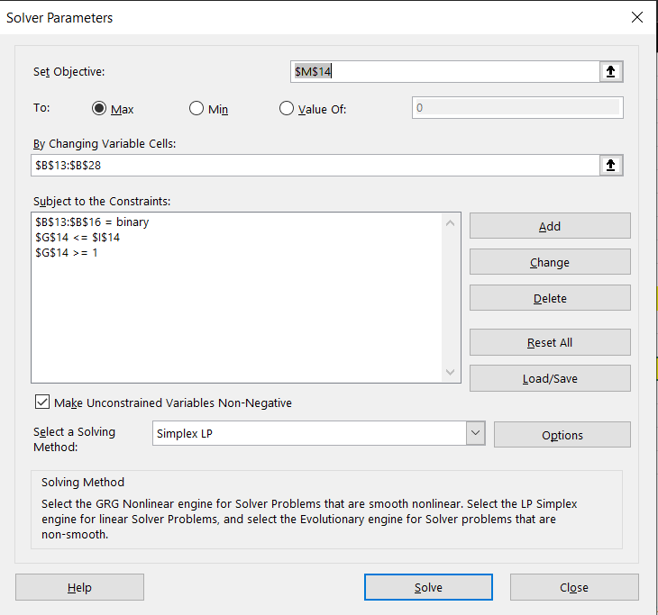
Appendix : Excel Solver Screen

Slide 13
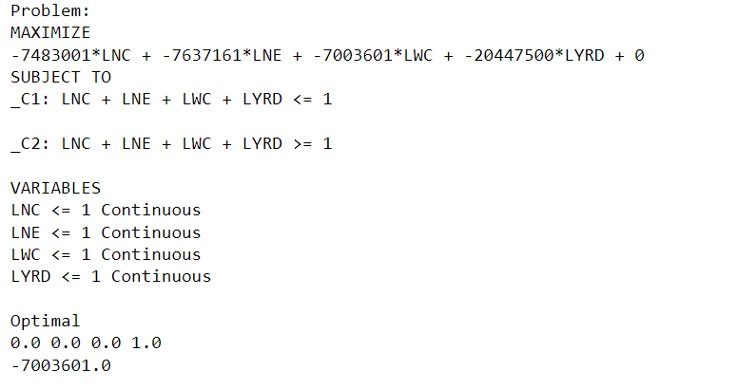
Appendix : Python Output

